Slide 1
Passwords
Offensive Security

Slide 2
Passwords
No need for an exploit if you already have away in
Gathering them
Using them

Slide 3
Cracking Passwords
If you gain a hash it isn’t always useful
Sometimes a hash is
Pass the hash attacks
Using a tool to “reverse” the hashes
Different types of hashes make for more difficult

Slide 4
Cracking Strategies
Brute force
Could take a very long time
Dictionary
Online
Rainbow table
Offline
So which do you use?

Slide 5
Cracking Tools
John the Ripper (JtR)
Hashcat
Online Tools
Never use with real customer data

Slide 6
Generated lists
Dictionary
Default lists
Rainbow Tables
Rainbow Crack
rtgen – generate tables
rtsort – Sorts the tables
rcrack – Lookup process

Slide 7
Types of Passwords
Encrypted
Hopefully not
Hashed
One way and not reversible
Many different types
Windows Hashed
LM
NTLM

Slide 8
Hashes
Any amount of data into a fixed length “fingerprint”
If even a single bit of data changes the entire hash changes
SHA1
SHA256/SHA512
MD2, MD4, MD5, MD6
https://en.wikipedia.org/wiki/List_of_hash_functions

Slide 9
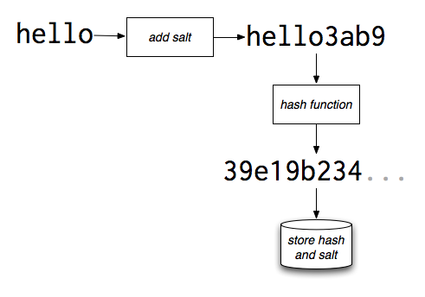
Salting Hashes
Causes lookup tables and rainbow tables to fail
In a table the salt is always the same
Append or prepend a random string before hashing
Salting Fails
Salt Reuse
Short Salt

Slide 10
Better Hashes
Salt generated using a CSPRNG
Keyed hashes
Slower hashing functions
PBKDF2, bcrypt, scrypt, argon

Slide 11
Identifying Hashes
Sometimes easily identifiable
/etc/shadow
Windows Hashes
Automatically
John the Ripper
HashID

Slide 12
Hashing & Cracking Demo
Sample Hashes:
http://openwall.info/wiki/john/sample-hashes

Slide 13
Default Credentials
Web Applications
Services
Tomcat
Organization default credentials
If the organization publishes new hire documentation?

Slide 14
Finding Them
Scripts
Enough access on the host
Get root on a system through other means
Check /etc/shadow /etc/passwd
Text document on desktop with the master password to the Keepass database that stores all other admin passwords for the network

Slide 15
Linux Passwords
/etc/passwd
Stores data about user
User ID, group ID, home directory, login shell
Not the password, but why is this important?
/etc/shadow
Hashed form of the password, if there is one
Type of Hash
Salt
Password expiration data
Take a look in Kali
Unshadowing

Slide 16
Windows Passwords
Passwords are stored in the SAM file
Security accounts Manager
%SYSTEMROOT%\System32\config\SAM
Typically C:\Windows
Protection
Use good passwords
Separate admin/user passwords
Change the password somewhat frequently

Slide 17
LM Hashes
LAN Manager
Used in older versions of Windows
Step 1: Convert to uppercase
Password1 = PASSWORD1
Step 2: Pad the plaintext with null chars to make it 14 bytes long
PASSWORD1 = PASSWORD1\0\0\0\0\0
Step 3: Split the password into two 7 byte/char chunks
PASSWOR D1\0\0\0\0\0
Step 4: Hash each chunk and concatenate
Step 5: Store in the SAM file

Slide 18
NTLM/NTLMv2
NTLM
Take unicode, mixed case password
Utilize MD4 to hash the password
NTLMv2
Cryptographically strengthened version of NTLM

Slide 19
Stealing Passwords
Mimikatz
Benjamin Delpy
LSASS Process
Defended by Windows Credential Guard

Slide 20
Other Tools
Mimikatz
Dcsync
Responder
Internal Monologue
Linux SSH

